Slide 1

Use of in-situ data for air quality assessment
The future of AQ monitoring for forecasting and policy support
Cristina Guerreiro
ENEON Workshop, Laxenburg 12th-13th October, 2016

Slide 2
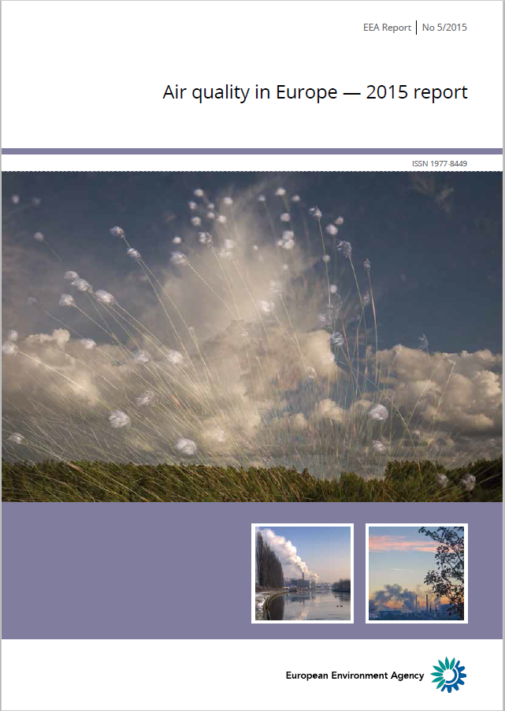

EEA Annual Air Quality Report
Since 2011
Overview and analysis of air quality situation in Europe
Vehicle to communicate air quality related facts, status, trends, key messages
Based primarily on reported in situ air quality data from EIONET

Slide 3
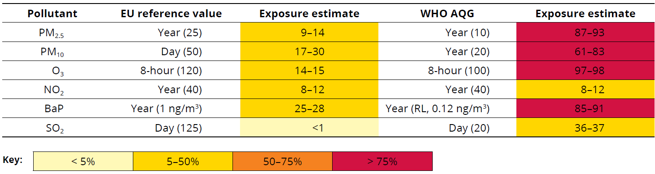
EEA Annual Air Quality Report based on EIONET air quality in situ data
  Status and trend analysis based on in situ measurements:
    PM₁₀ & PM_{2.5},
    O₃,
    NO₂,
    Benzo(a)pyrene
    SO₂,
    CO,
    Benzene,
    Metals
% of urban population exposed to concentrations above EU/WHO values
    Urban population exposure
    Concentration mapping based on measurements + models:
      Health impacts
      Ecosystem impacts

Slide 4
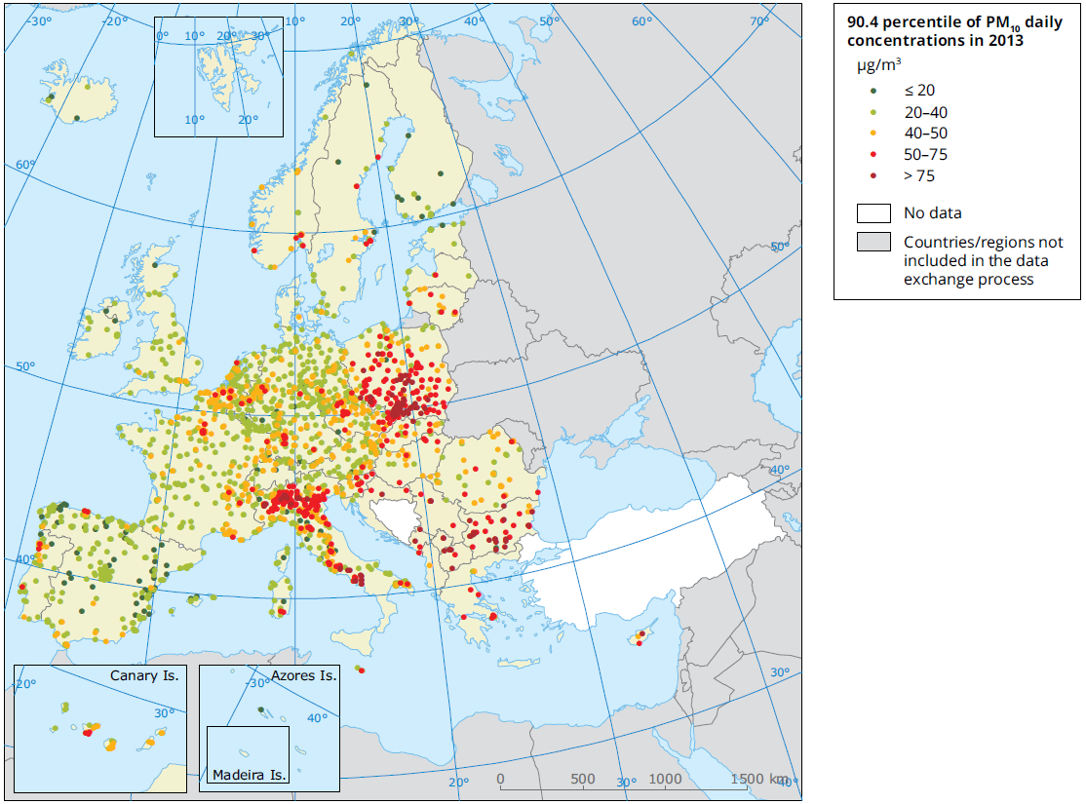
Particulate matter: PM₁₀
EU daily limit value = 50 µg/m³
(35 days allowed) ⬄ P90.4
EU annual limit value = 40 µg/m³
WHO daily guideline = 50 µg/m³ (3 days allowed)
WHO annual guideline = 20 µg/m³
Source: EEA Report 5/2015

Slide 5
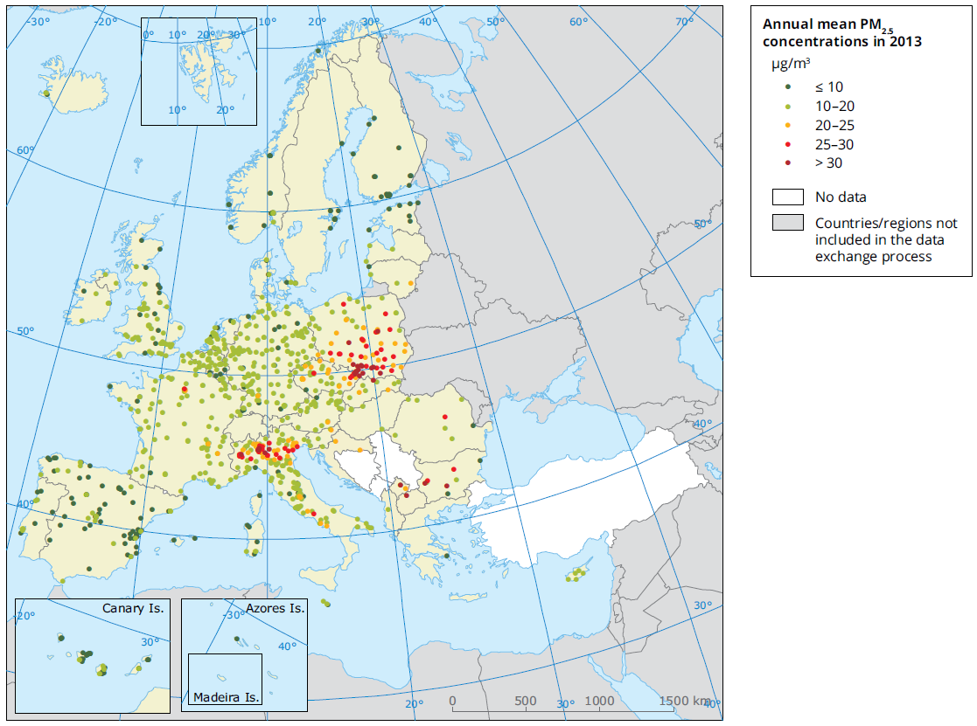
Particulate matter: PM_{2.5}
EU target value = 25 µg/m³
WHO guideline = 10 µg/m³
Source: EEA Report 5/2015

Slide 6
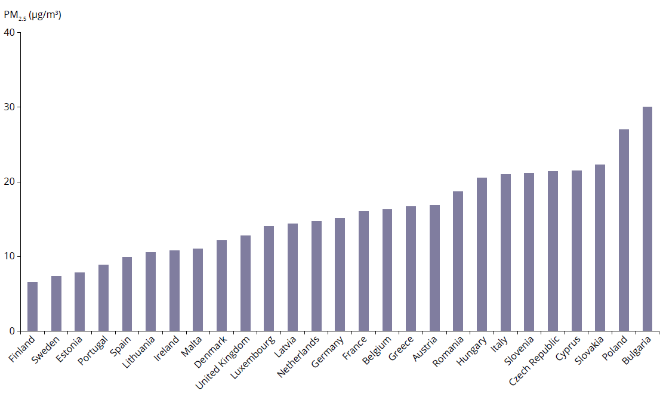
Average exposure indicator: PM_{2.5}
Based on measurements at urban background stations
Exposure concentration obligation: 20 μg/m³
Source: EEA Report 5/2015

Slide 7
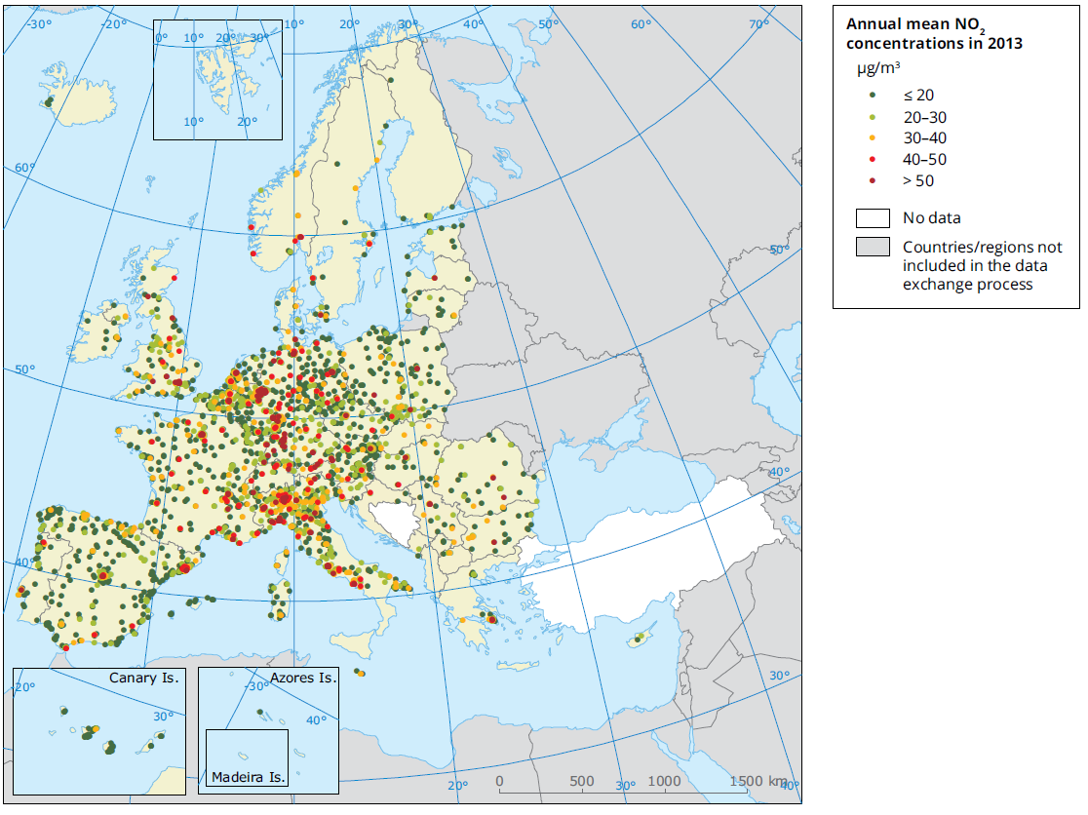
Nitrogen dioxide - NO₂
93% of exceedances occur at traffic stations
Station classification is key!
Good metadata
EU annual limit value & WHO guideline = 40 µg/m³
In red and dark red: above EU limit value
Source: EEA Report 5/2015

Slide 8
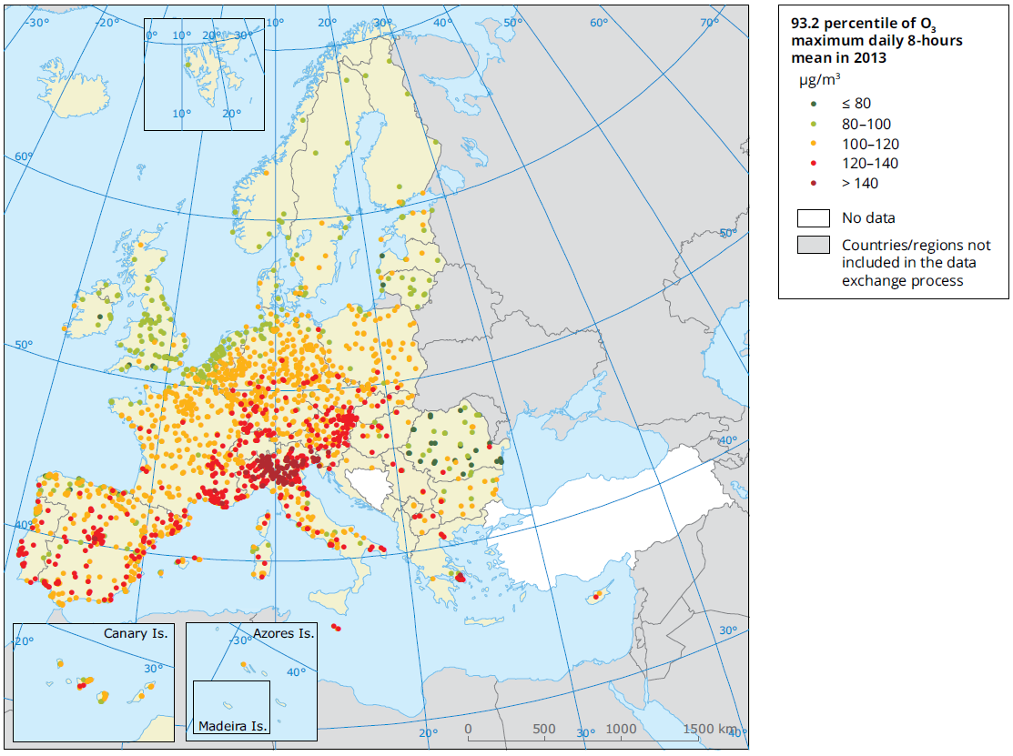
Ozone – human health
EU limit value = 120 µg/m³
(25 days allowed ⬄ P93.2)
WHO guideline = 100 µg/m³
Source: EEA Report 5/2015

Slide 9
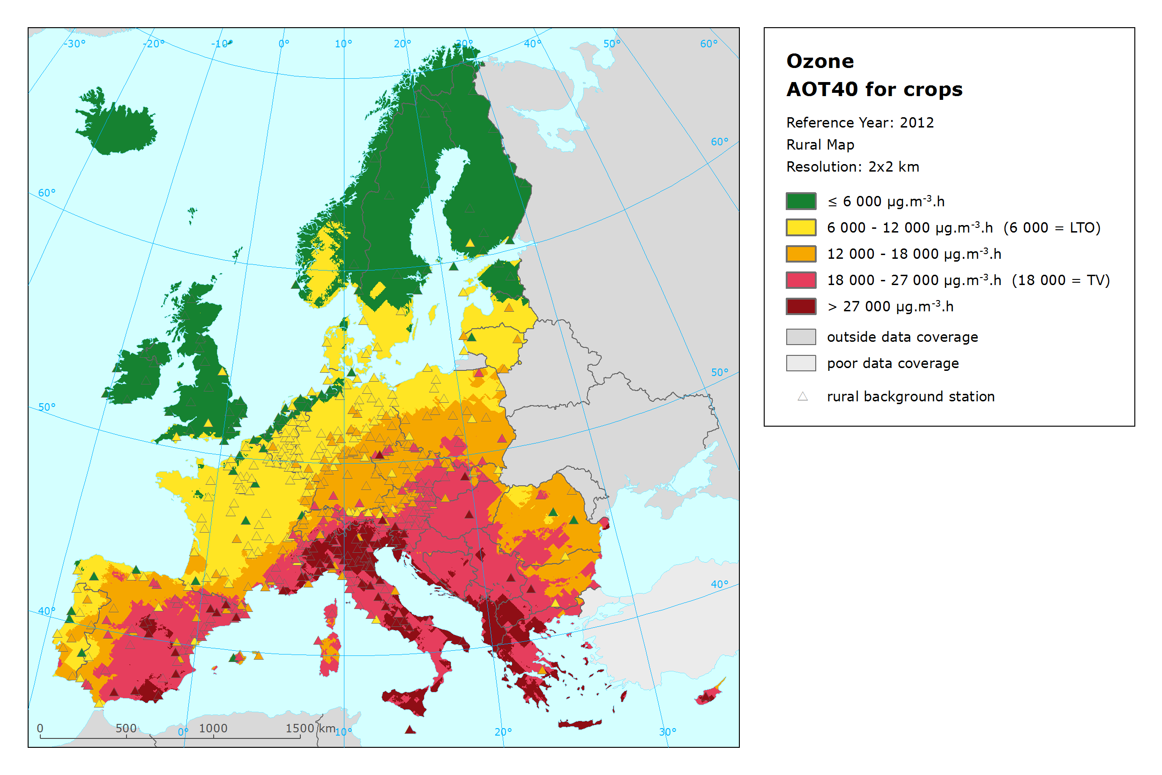
Ozone – crops
AOT40 is an accumulated ozone exposure:
Sum of hourly O₃ conc above 80 μg/m³ from 8 to 20 hr accumulated from 1 May to 31 July.
Source: ETC/ACM TP 2014/4

Slide 10
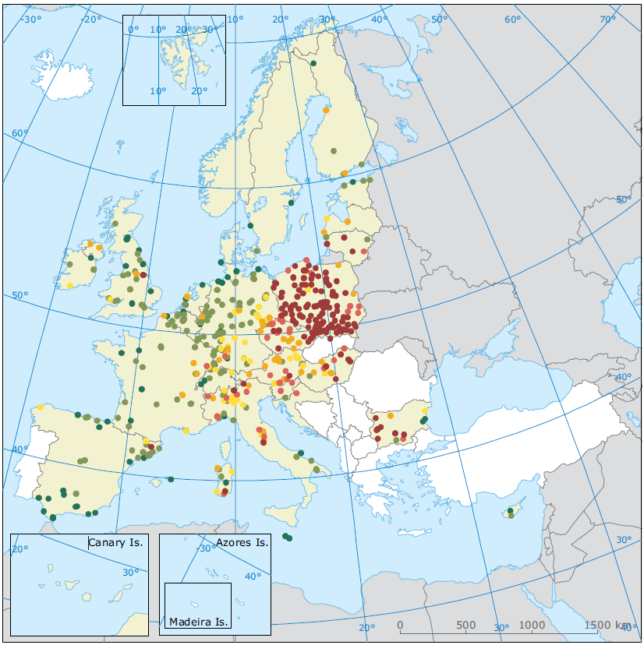
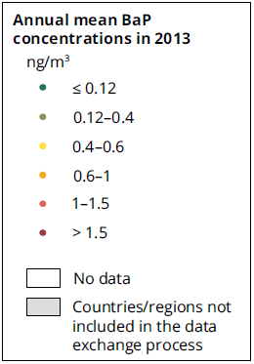
Benzo(a)pyrene
Difficult to assess population exposure in areas with few stations;
Emission inventories are very uncertain
  No emission reporting obligation
EU target value : 1 ng/m³
Reference value : 0.12 ng/m³
Source: EEA Report 5/2015

Slide 11
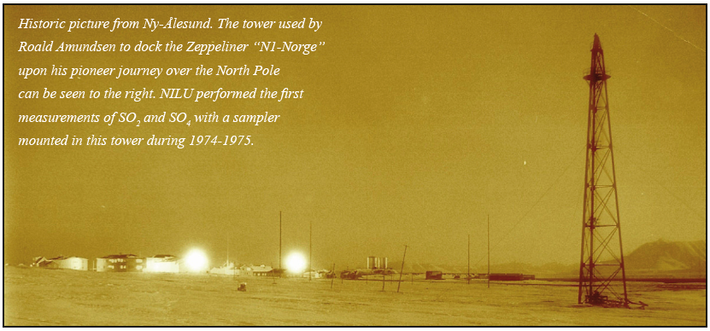
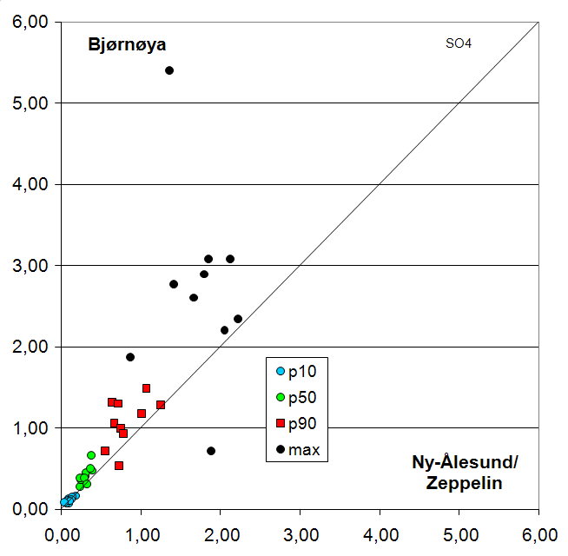
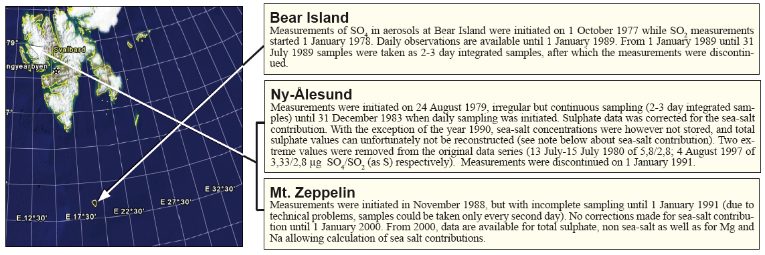
Trend analysis:
Longterm series unique to in situ
1978
1979
1989

Slide 12
The future of AQ monitoring for forecasting and planning activities

Slide 13

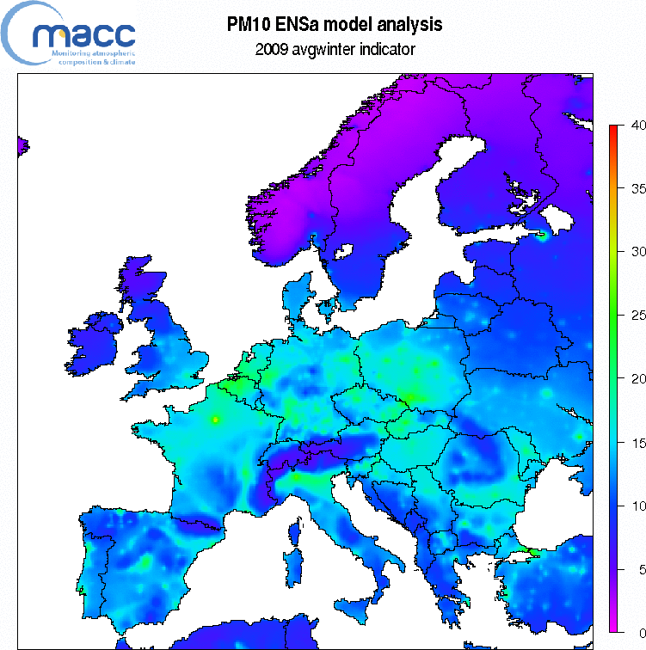
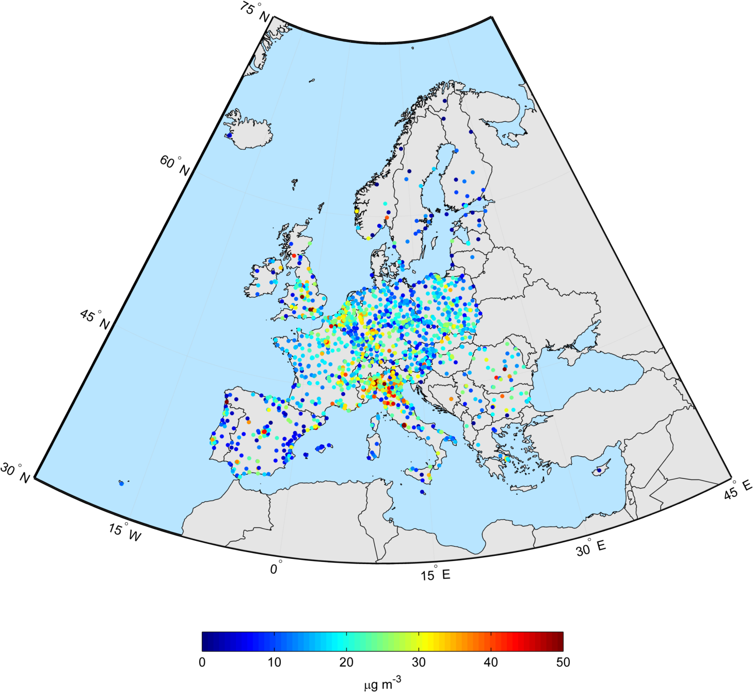
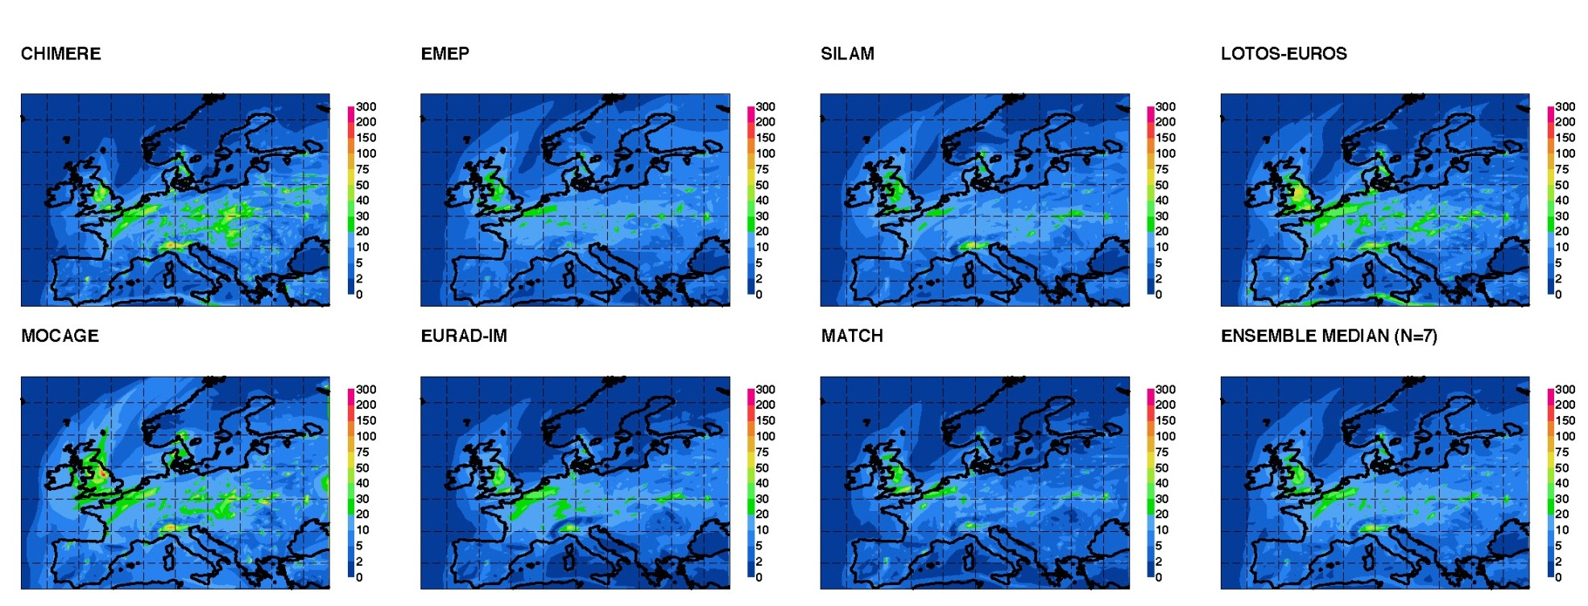
Forecasting activities
Air quality monitoring strategy must consider station representativeness, geographical coverage.
Foster the development of NRT data reporting
Observations in NRT
Data assimilation
Ensemble of models
Analyses and Forecasts

Slide 14
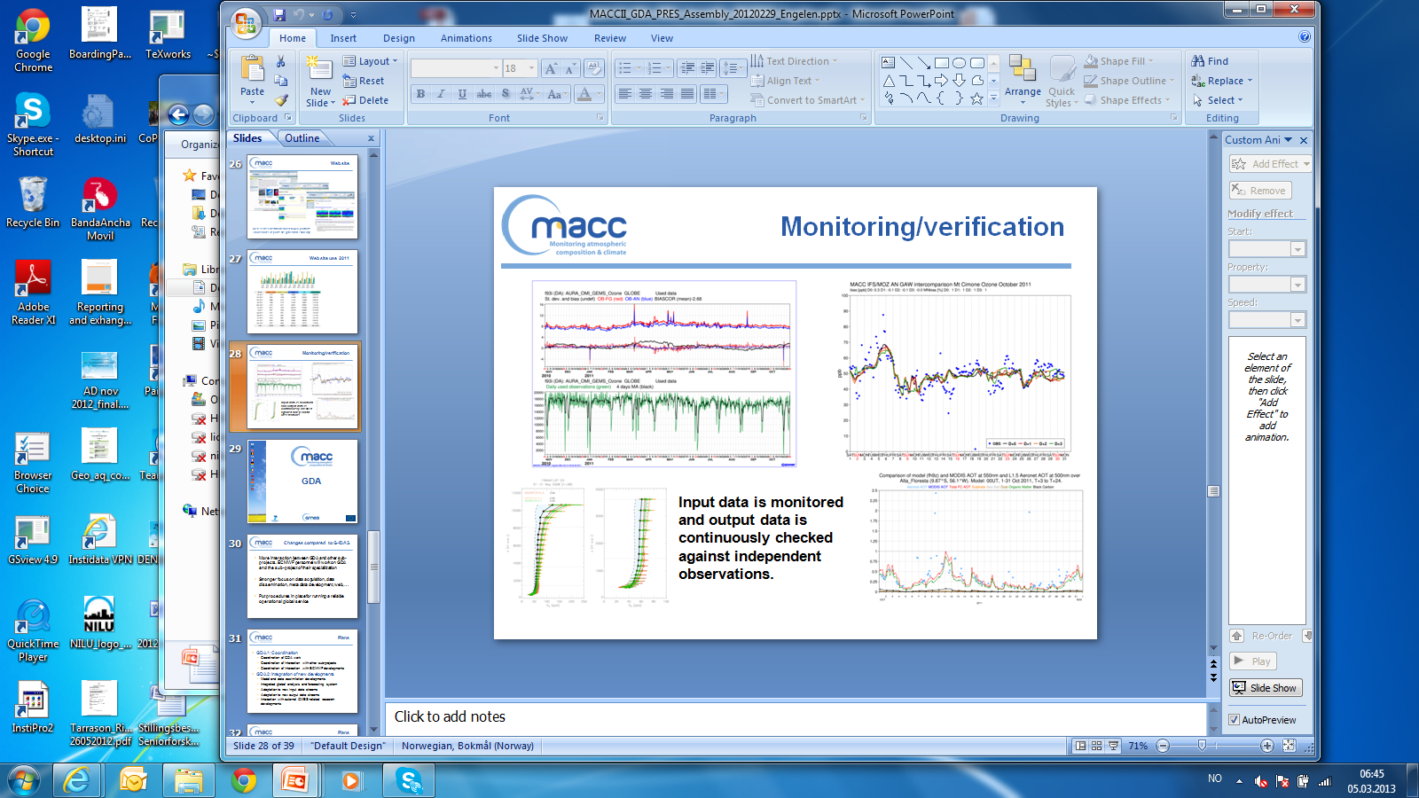
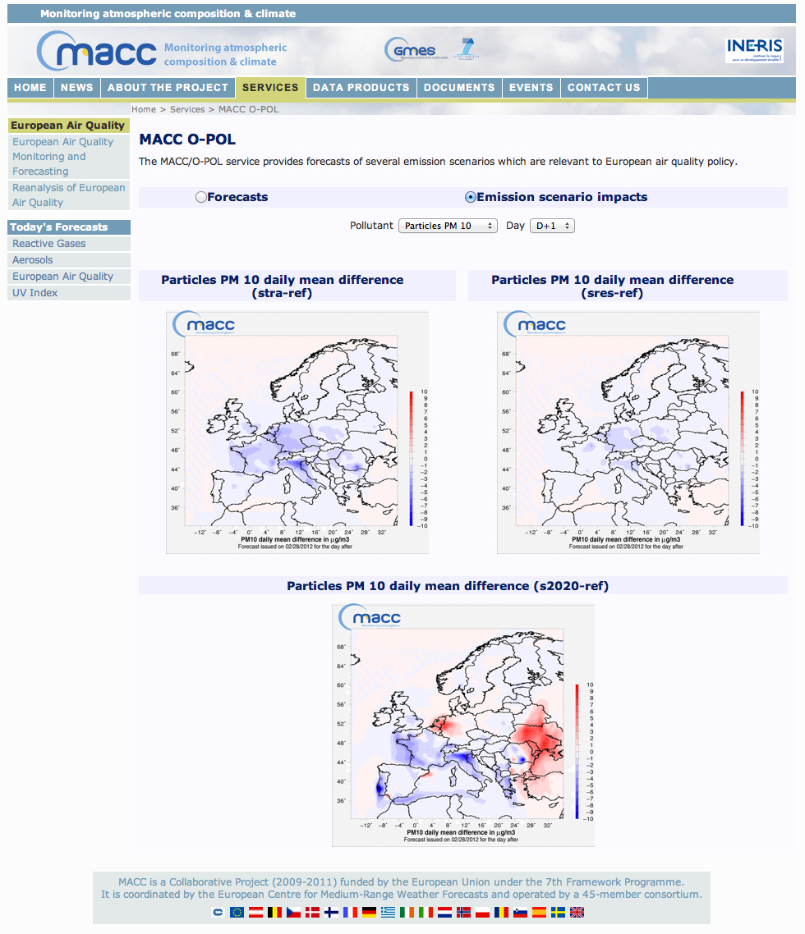
Use of the forecasting skills to assess future emission reduction scenarios
Forecasting needs
On-line observations (NRT )
Observations for process understanding
Provides:
Continuous validation
Robust scientific basis for planning future scenarios

Slide 15
Routines to identify long transport episodes in NRT (in-situ measurements, models, satellite data)

Slide 16
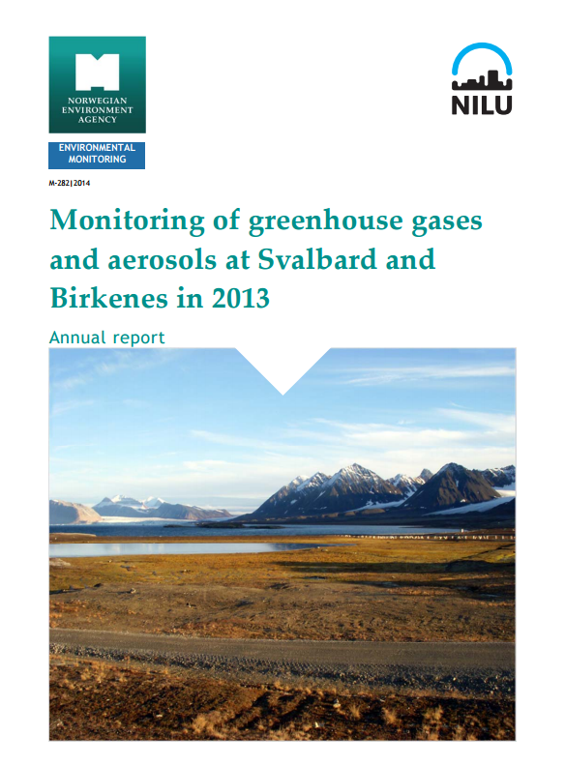
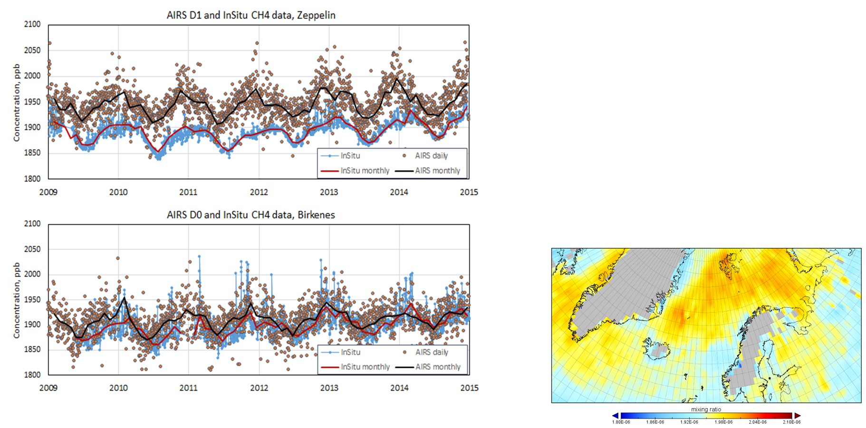
Methane: in-situ to validate satellite data
Large bias:
  ~52 ppb Zeppelin,
  ~10 ppb Birkenes
OK monthly mean correlation (~0.7) - might be due to the a-priori values
NEOS-ACCM project - AIRS and In-Situ CH₄ data, 2009-2014
Notes:
Satellites give an important contribution to the global GHG mapping, but they cannot replace the ground-based monitoring network. Earlier studies (Vik et al., 2011, Stebel et al., 2013) have shown that the uncertainty in satellite products, particularly in polar areas, are too large to be used alone in reporting to national authorities and international projects and programs. However, the satellite products make it possible to investigate the geographical extent of e.g. enhanced methane concentrations, emission and long-range transport
The high AIRS methane concentrations in the polar region are probably caused by the reduced sensitivity and uncertain retrieval algorithms at high latitudes
Important applica$ons I.Iden$fica$on of natural and anthropogenic source regions and source strengths II.Data from regions with few ground based data •CO2 Few products available except for GOSAT. We are uncertain about the quality of this products. •CH4 SCIAMACHY and GOSAT can measure CH4, but the quality of these products are currently not sa%sfactory, and also to a certain extent unknown. •N2O Available from SCIAMACHY, but the quality of this product is uncertain.

Slide 17

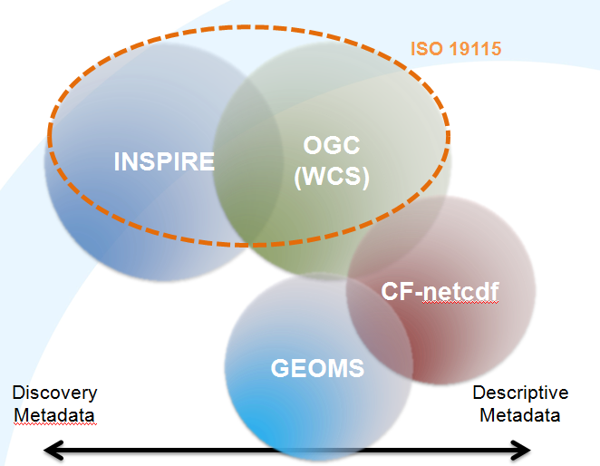





Metadata spaces and interoperability
Identify essential metadata elements needed for dataset and service discovery and use
Advance common understanding of interoperability
Formulate best practices for metadata generation and use
Joint approach for emissions, models, in situ and remote observations
Workshop on Air Quality and Atmospheric composition Metadata , Dublin, September 2012

Slide 18

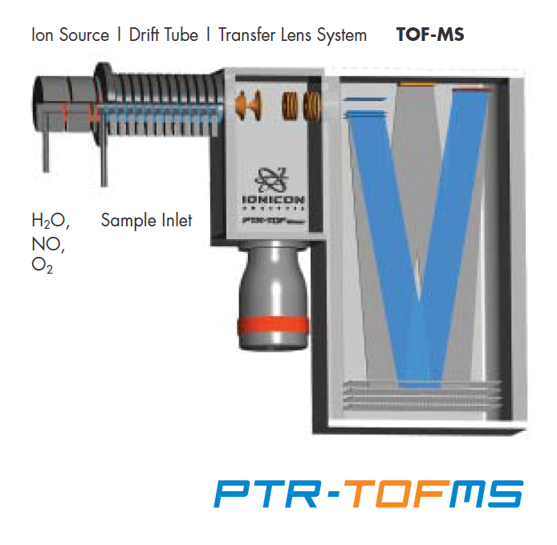
Future of AQ monitoring
Will we measure the same components ?
Probably stronger focus on chemical speciation and physical characterisation of aerosol
BC-EC/OC
VOC – SOA
CH₄, O₃, CO₂
PNC, Particle size
Nanoparticles
PAHs, Metals
BIEBUS - Use of bioethanol in Oslo city busses
PTR-TOF – organic compounds (ethanol, aceticethanol, acetic acid, aldehydes, etc.)

Slide 19

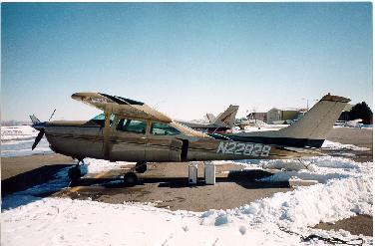
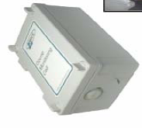
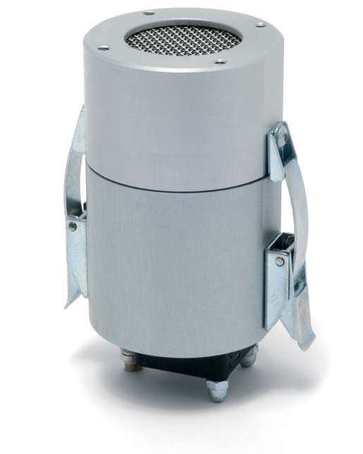
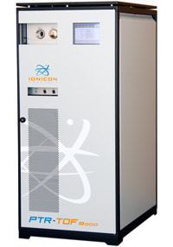
Future of AQ monitoring
Will we measure with the same instruments ?
Instrument evolution in two directions:
NOWCASTING
Less expensive instruments
Less maintenance
Lower accuracy and traceability
Need for equivalence testing
FORECASTING AND PLANNING
Need for accurate measurements
Physical and chemical properties
Vertical profiles
OMC2
Sens300

Slide 20
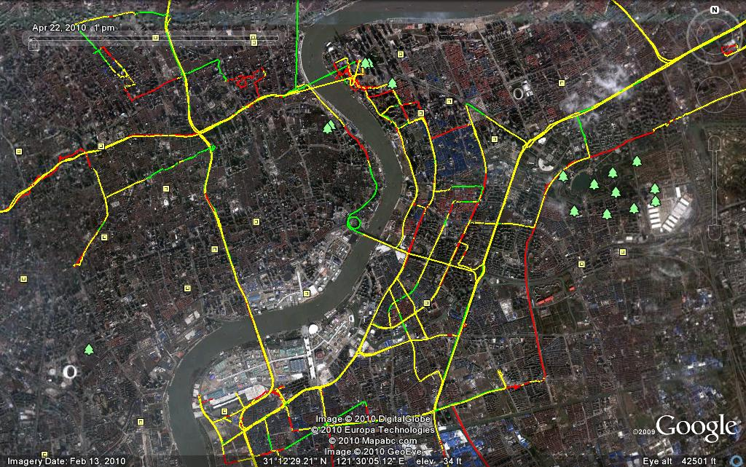

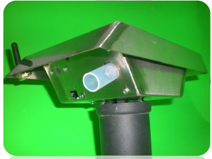
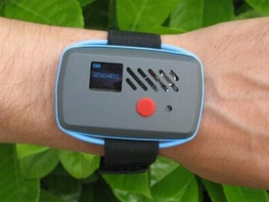

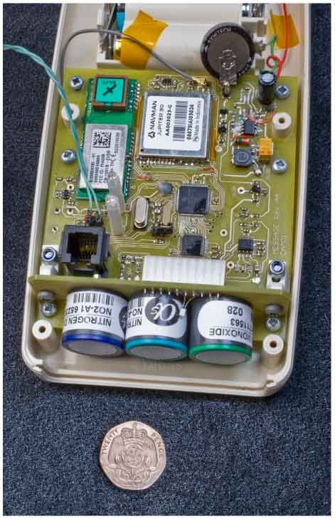

Nowcasting activitivies
Use of microsensors (e.g. CITISENSE)
Use of micro-sensors in air quality monitoring
Green cities – sustainable planning and forecasting
Information in near real-time (NRT) – Nowcasting activities
Increased population involvement

Slide 21
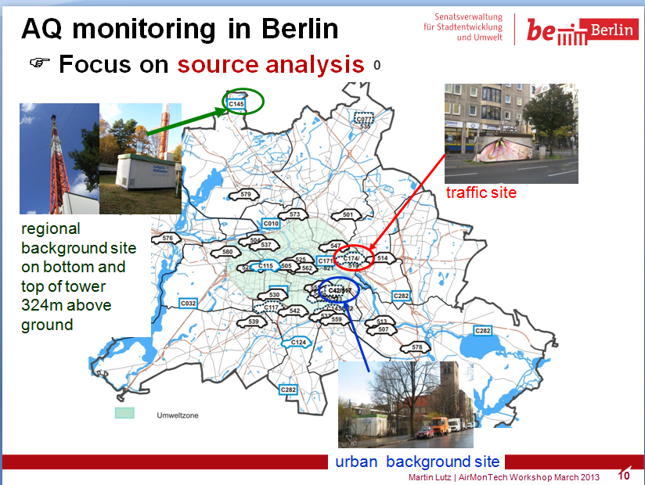
Future AQ monitoring
Will we measure in the same networks ?
Evolution of the network:
Less stations?
More microsensor use?
More specialised urban observatories?
  Urban Supersites for specific microenvironments
  for forecasting,
  process understanding,
  planning activities

Slide 22
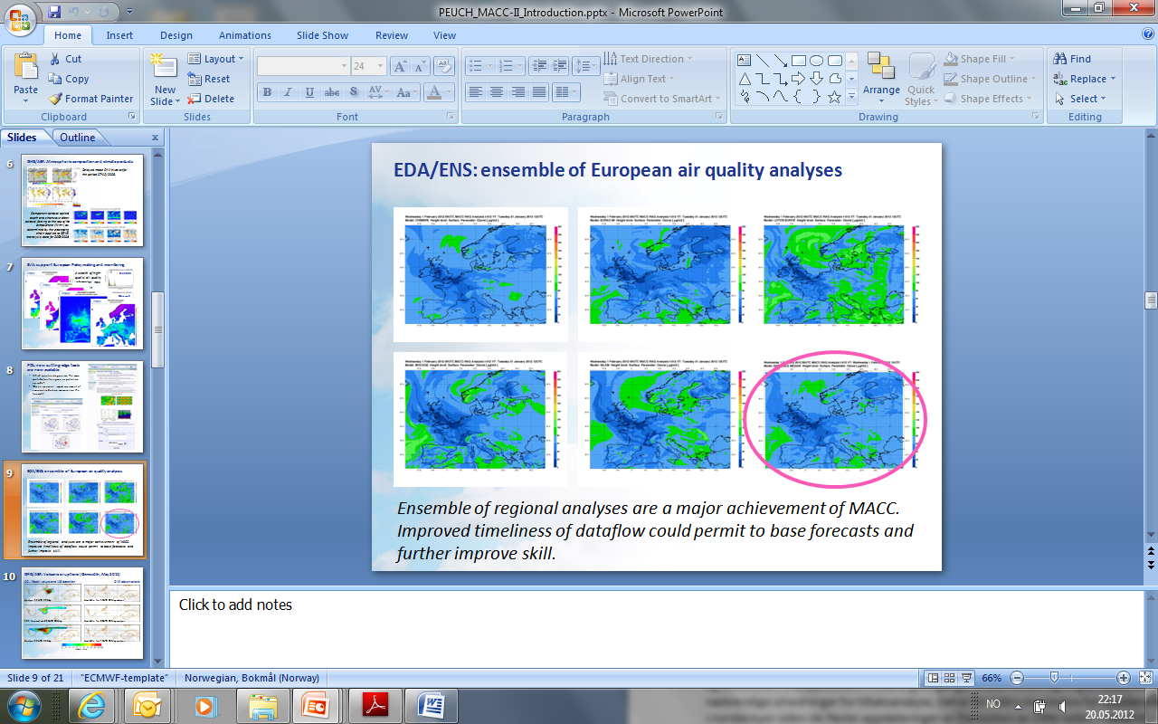
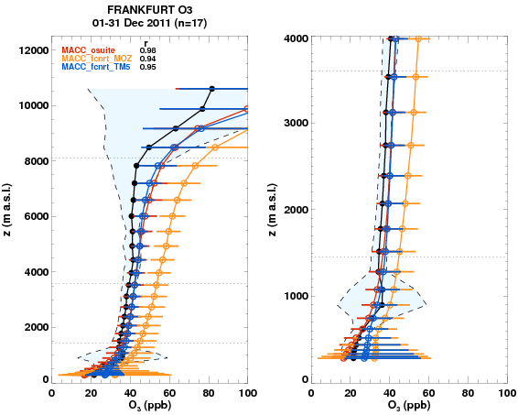
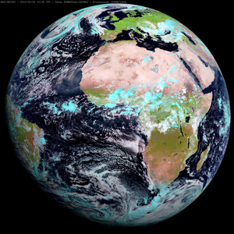
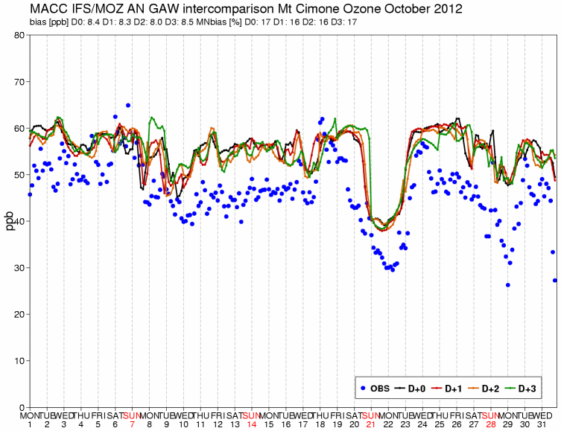
Future of AQ monitoring
Will we have the same models?
Evolution of models:
Observations are key to process understanding and method development!
  Process studies
  Better parametrisations

Slide 23

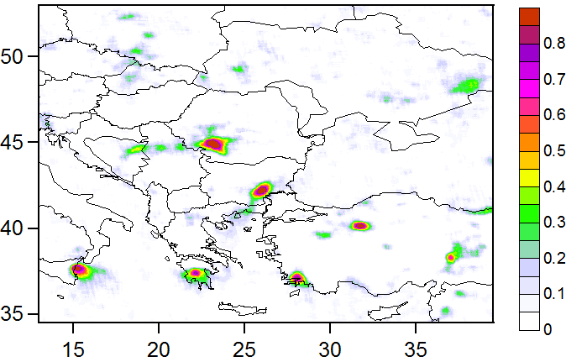
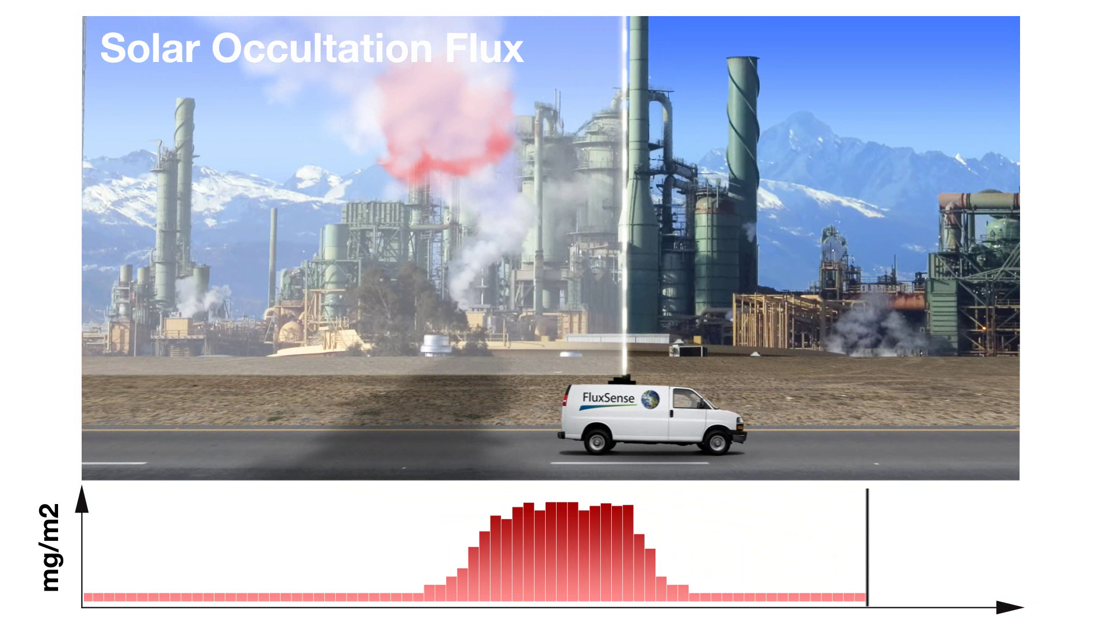
Future of AQ monitoring
Will we have the same emissions?
    In-situ measurements of emissions
    Integrated methods (combined models and observations, inverse modelling, data assimilation)
    Multispecies measurements/ analysis
    Optical new observations (both ground-based + satellite)
    Eddy covariance flux methods

Slide 24
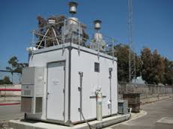


Air quality in situ data
Future of AQ monitoring
Support services using in situ AQ data
Processing
Data
Infrastructure
Local
Energy
Environment
Transport
Health
Industry
Risk Analysis
Health quality
Services:
Smart cities
Smart buildings
Indoor air
Exposure
Health-effects
Early warning
Smart mobility
Global
«Big data»

Slide 25
In summary
In situ air quality data is central to:
  Air quality assessment (alone/ in combination with other information)
  Trend analysis
  Process understanding (e.g. physical and chemical speciation of aerosol, specially on SOA and VOC)
  Development of models and modelling validation
  Calibration of satellite data
  Emission measurements
  Increased focus on data access and interoperability
In the future:
  More demand for NRT data: forecasting, public information, analysis of episodes (geographical origin and sources)
  Need for extended monitoring design combining in situ & remote measurements, NRT emission data and models using NRT data assimilation

Slide 26
Thank you for your attention!
Cristina.Guerreiro@nilu.no

